Slide 1
Research methods in psychology
Prof: Dr. Doe Buchli
Fall 2016
Mercer University

Slide 2
The need for psychological science
Prevalence of pseudoscience and misinformation
Hindsight bias (isn’t psychology just studying the obvious?
Other biases and/or limitations of human intuition?
Notes:
Limitations of human intuition – over-confidence, perceiving order in random events, gambler’s fallacy, hot-hand. All account to the minunderstanding of randomness and probability

Slide 3
So, research...Where to start?
Observation
Theory
Hypothesis
Test
Analyze Data
Refine
Notes:
Observation: Pattern of behavior or a perceived relationship between variables
Theory: Explanation derived from an organized set of observations; Leads to testable hypotheses
Hypothesis: Predicts an outcome based on theory; requires operational definitions
Test: Many methodologies to choose from: Descriptive, correlational or experimental
Analyze
Refine

Slide 4
Observation
Pattern of behavior or a perceived relationship between variables
EXAMPLE: I seem to do better on exams when I eat chocolate beforehand

Slide 5
Theory
Explanation derived from an organized set of observations
Leads to testable hypotheses

Slide 6
Hypothesis
Predicts an outcome based on theory
Requires operational definitions
A definition that specifies how we are measuring the phenomenon we are studying
Must have precision and validity
Would another researcher given the same operationalization implement the study in the same way?
Does it actually measure the concept you’re interested in?
EXAMPLE: Eating chocolate leads to gains in cognitive performance
Notes:
What will be “eating chocolate” — what chocolate? Any sugary snack? How much? Before or during the task?
What is cognitive performance? — Concentration and attention? Memory for a list of words? How fast I can complete a Sudoku puzzle?
A good hypothesis requires a good operational definition. That allows replication - allows us to value the effectiveness of the research when other researchers replicate

Slide 7
3 ways to Test Hypotheses
Experimental methods
Correlational methods
Descriptive methods
Notes:
Descriptive and correlational: Looks at patterns of behavior across conditions
Links variables which show consistent patterns or relationships

Slide 8
Experimental Methods
Purpose is to explore cause and effect by manipulating one or more factors, while holding other factors constant

Slide 9
Naming the variables
Independent variable
What is being studied
Dependent variable
The variable that is expected to change in response to the independent variable
Also know as the “outcome variable”
Extraneous | Confounding variable
Any variable that we cannot control which may also affect your results
Notes:
Principle: try not to let the confounding variables vary!
How to prevent the confounding variables from varying in the ice cream example: you could do all your data collection only on days in which the high temperature is 70 degrees (but why 70 degrees? why not 60 or 80 degrees? Or make the temperature a third variable? But then what about humidity?).

Slide 10
Confounding Variables
Variables, other than the independent variable, which could inadvertently influence the dependent variable
“Outside factors” that could have caused your results.
Need to be controlled/eliminated in order to draw a true, cause-effect relationship in the experiment.
Many confounding variables can be eliminated through random assignment.
Notes:
To counter, can use random assignment

Slide 11

Independent and Dependent Variables
An Example: Does breastfeeding children have an impact on their intelligence later in life?

Slide 12
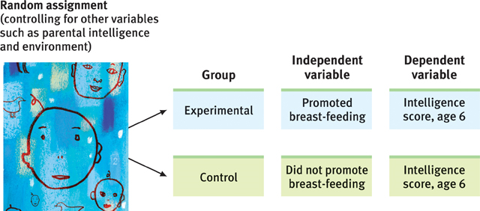
Independent and Dependent Variables
The independent variable is whether mothers are assigned to an experimental condition in which their children breast feed, or to a control condition in which they feed their children formula.

Slide 13
Independent and Dependent Variables
The dependent variable is the child’s score on an intelligence test at age 6. (This is the measureable aspect of psychological functioning that we think may be influenced by the independent variable.)

Slide 14
Random Assignment
Random assignment – assigning participants to experimental and control groups by chance, thus minimizing preexisting differences between the groups that could affect the dependent variable (e.g., SES).

Slide 15
Cause
Effect
Notes:
Experiments allow us to study Cause and Effect
Asked in exams. Reword better
Advantages of Experiments allow us to establish cause and effect
Disadvantages of Experiments cost a lot of time and effort and sometimes money. Also, the experiments are artificial, thus it is hard to mimic reality. People behave differently in lab than in real-life. 3rd disadvantage is that it is sometimes not possible to change (???) variables, like biological(gender) or ethical(exposure to pollution)

Slide 16

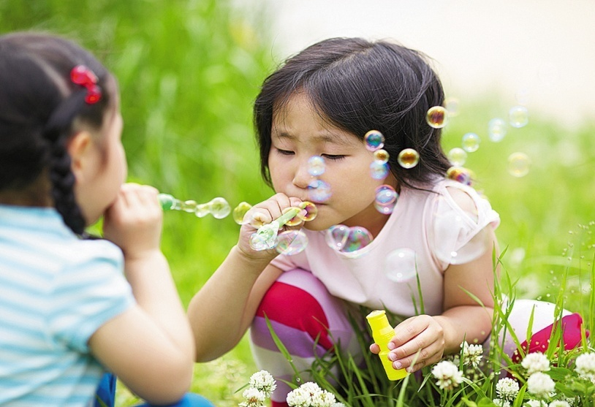
Sometimes it’s not possible to conduct an experiment. For example, it isn’t possible to assign a child to be male or female for the purpose of an experiment.

Slide 17

Other times, it’s not ethical to conduct an experiment. For example, it would be unethical to assign people to be exposed to polluted air or non-polluted air for the purpose of seeing whether pollution has a negative effect on mental functioning.

Slide 18
Correlational Methods
Purpose is to observe naturally occurring relationships between variables

Slide 19
Correlational Methods
Correlation coefficient – a statistical index (-1 to 1) of the relationship between two variables

Slide 20
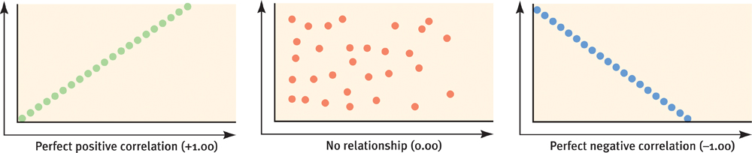
Scatterplot – a graphed cluster of dots, each of which represents the values of two variables. The slope of the points suggests the direction of the relationship, while the amount of scatter suggests the strength of the relationship.

Slide 21
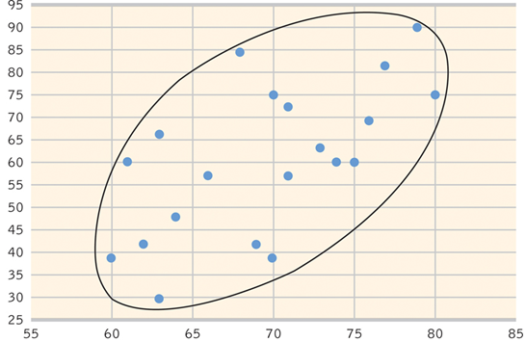
Test Score
Time Spent Studying

Slide 22
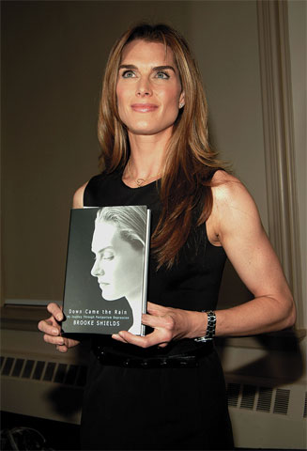
We might theorize that the cause of depression is low self-esteem - one’s feelings of self-worth.
We might hypothesize that depression and self-esteem will correlate negatively.
We might test this hypothesis by seeing if people who receive a low score for self-esteem tend to receive a high score for depression.

Slide 23
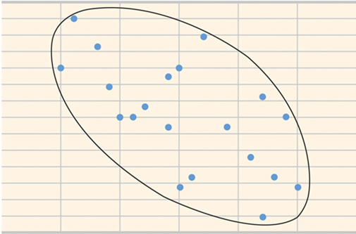
Correlation and Causation
30
25
20
15
10
5
0
Depression
0 5 10 15 20 25 30
Self Esteem

Slide 24
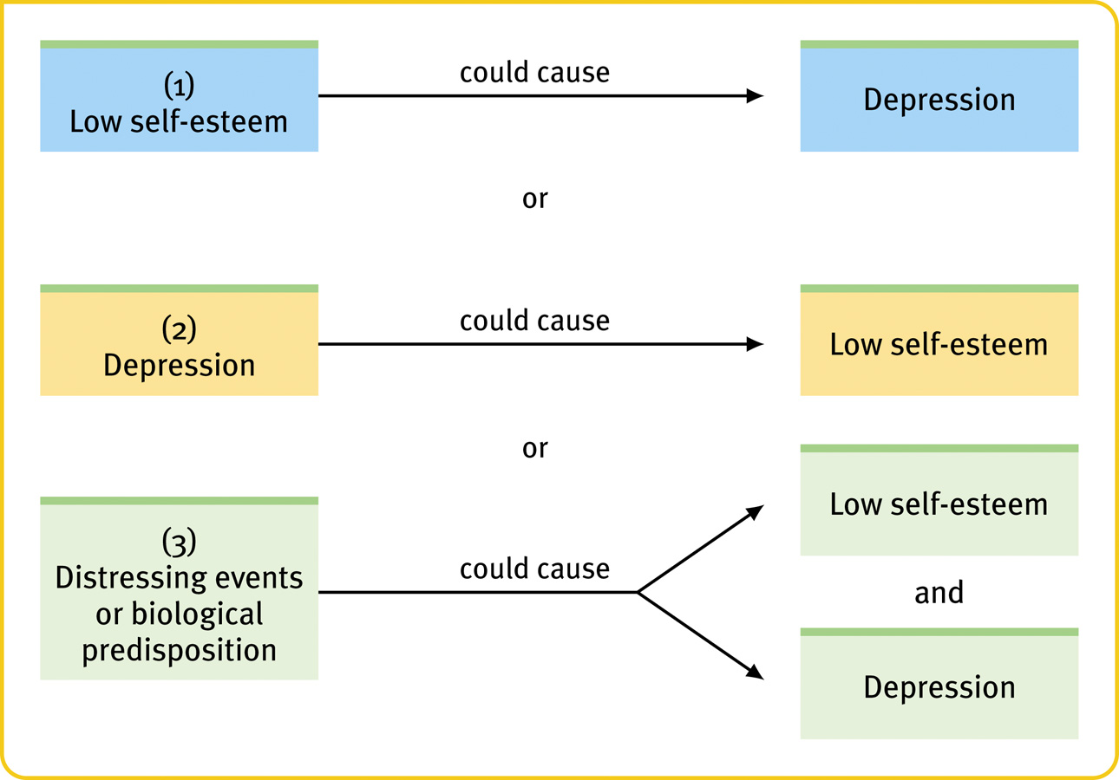
Correlation and Causation
or

Slide 25
Correlation and Causation
Correlation != causation
or

Slide 26
Correlation and Causation
or
Notes:
Directionality problem
Variable A affects Variable B
or
Variable B affects Variable A.
But unknown Variable C is the real link

Slide 27
Testing Hypotheses: Correlational Methods
Examples:
Keeping a food diary doubles diet weight loss
Teen use of pot can lead to dependency, mental illness
Church attendance boosts immunity
Ice cream leads to murder
Notes:
FOOD DIARY. The findings, from one of the largest and longest running weight loss maintenance trials ever conducted…"Those who kept daily food records lost twice as much weight as those who kept no records. It seems that the simple act of writing down what you eat encourages people to consume fewer calories.”
POT: A teen who has been depressed at some point in the past year is more than twice as likely to have used marijuana as teens who have not reported being depressed - 25 percent compared with 12 percent,… using marijuana increases the risk of developing mental disorders by 40 percent, the report said. And teens who smoke pot at least once a month over a yearlong period are three times more likely to have suicidal thoughts than nonusers, it said.
CHURCH: Blood tests showed that regular attendees were less likely to have high levels of an immune-system protein involved in age-related diseases. Earlier studies found a correlation between religious observation and good physical health, but it wasn’t clear if healthy individuals simply get to church regularly or if church attendance itself delays a decline in physical well-being.
EGG” He said the study fails to take exercise or other dietary habits into account. Study participants could have consumed more salt, or they could have been on cholesterol-reducing drugs, too.
“It may be that people who consume a lot of eggs also consume a lot of other fatty foods,” Frid said, adding that how the egg is prepared should also be taken into account.
Ask: why do we bother with them at all if it is a causal relationship that we seek? Why not just gather data that could provide a more definite answer, or otherwise just ignore correlations? The reason is pragmatism. Correlational data are usually relatively easy and inexpensive to obtain, at least in comparison to experimental data. Also, many cause-effect relationships are so subtle that we often first learn of them through correlations detected in observational data. That is, they are often useful.

Slide 28
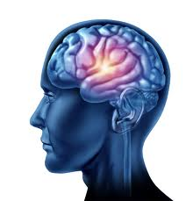
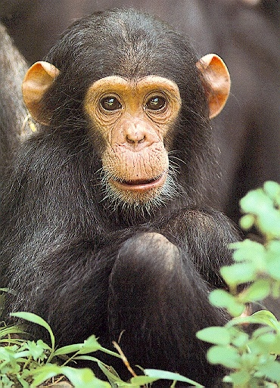

Testing Hypotheses: Descriptive Methods
Case studies: Observing and gathering information to compile an in-depth study of an individual or small group
Naturalistic Observation: gathering data about behavior in their natural habitat, watching but not intervening
Surveys: Gathering many people’s thoughts, attitudes and behaviors through self-report
Notes:
Case Studies
In-depth study of an individual or small group
Provides systematic observations
Limited generalizability
Susceptible to researcher bias
Benefit: can be a source of ideas about human nature in general
Example: cases of brain damage have suggested the function of different parts of the brain (e.g. Phineas Gage)
Danger: overgeneralization from one example; “he got better after tapping his head so tapping must be the key to health!”
Naturalistic Observation
Observing “natural” behavior means just watching (and taking notes), and not trying to change anything.
This method can be used to study more than one individual, and to find truths that apply to a broader population.
Survey:
Large sample size possible
Often based on questionnaires and interviews
Wording effects
the results you get from a survey can be changed by your word selection.
Example:
Q: Do you have motivation to study hard for this course?
Q: Do you feel a desire to study hard for this course?

Slide 29
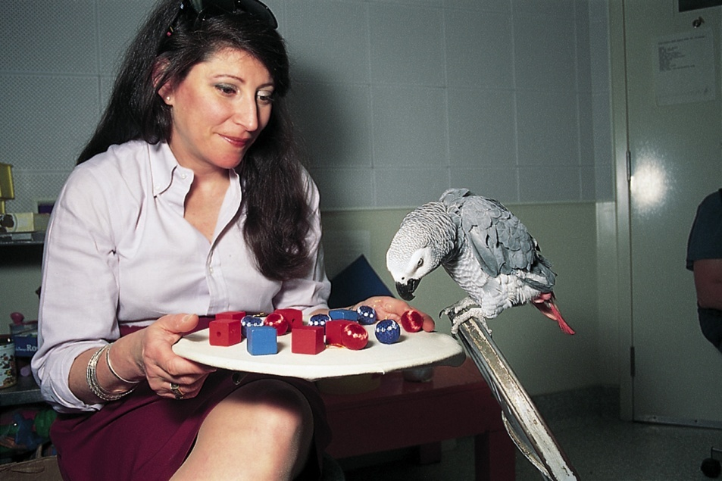
The Case Study
Through a 30-year case study, Irene Pepperberg concluded that African Grey parrot Alex could name and categorize objects, and comprehend numbers up to six.
http://www.youtube.com/watch?v=7yGOgs_UlEc

Slide 30
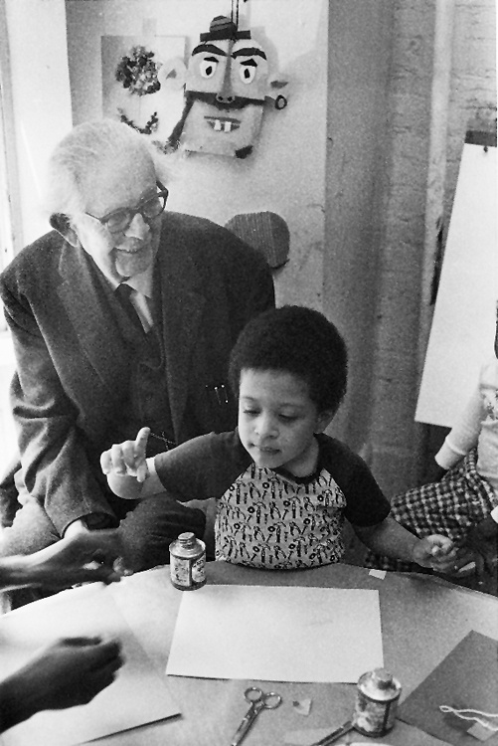
The Case Study
Through a series of case studies, often of his own children, Jean Piaget developed an influential theory of cognitive development, which assumes that cognitive functions unfold through a series of distinct stages.

Slide 31
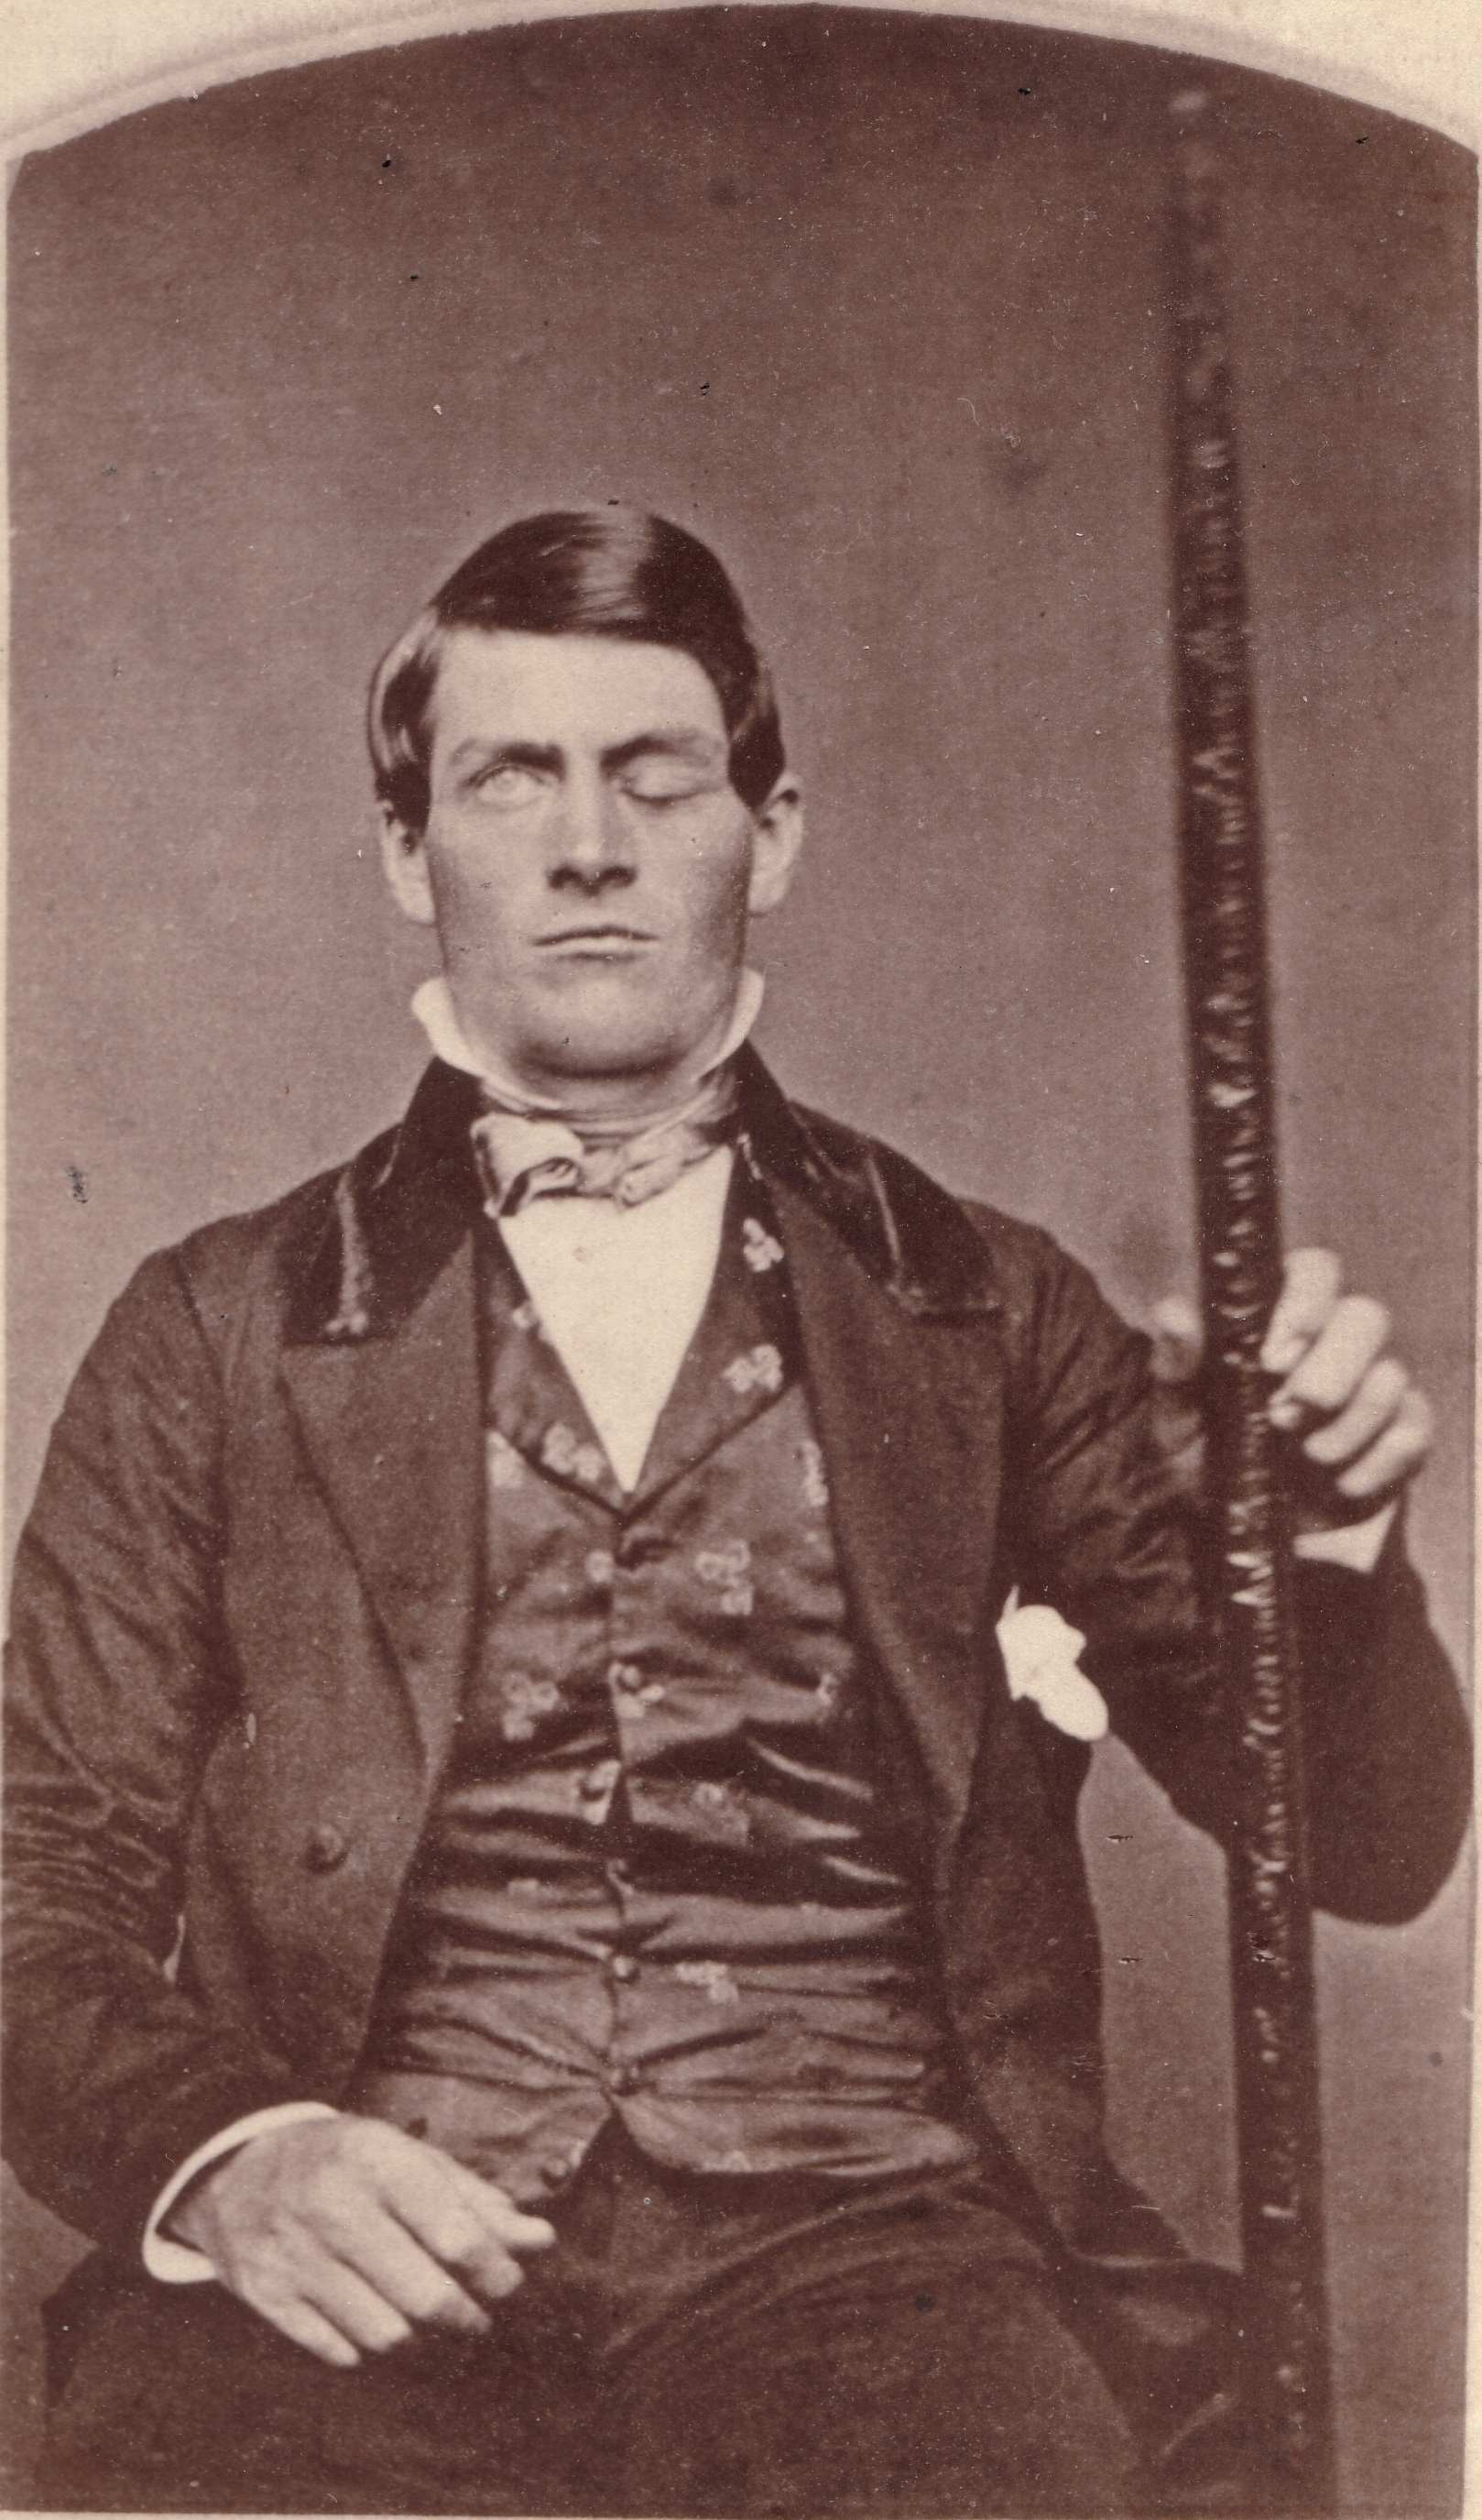
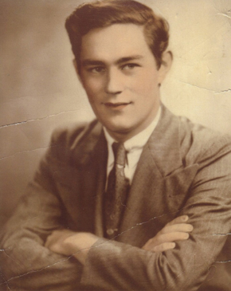
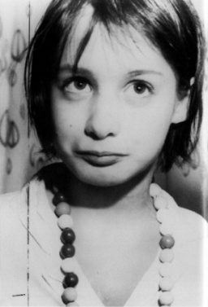
The Case Study
Useful for studying aberrant cases; individuals with rare neuropsychological disorders or who find themselves in unusual circumstances
Notes:
1st guy. Guy with rod through eye. Personality change
2nd guy. Henry Molasim? Removed his “memories”. Inability to form new memories
Girl. Genie. Effects of deprivation

Slide 32
Descriptive Methods
The Survey – an investigation of many cases in less depth by asking people to report opinions and behaviors

Slide 33
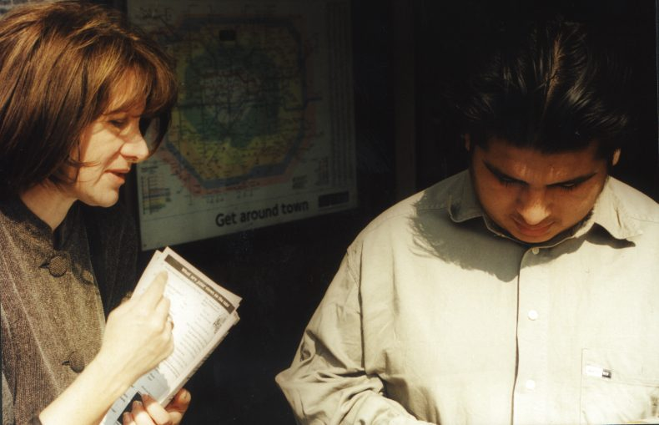
The Survey
A technique for ascertaining the self-reported attitudes, opinions or behaviors of people usually done by questioning a representative sample of people—one that accurately portrays the population of interest.

Slide 34
Descriptive Methods
Naturalistic Observation – recording behavior in its natural environment, and describing it in detail

Slide 35
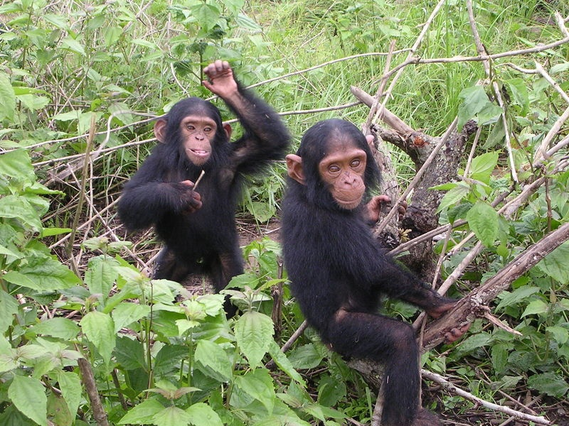
Naturalistic Observation
Primatologist Jane Goodall used naturalistic observation to study chimpanzees. She concluded, “Observations, made in the natural habitat, helped to show that the societies and behavior of animals are far more complex than previously supposed.”
Credit: Delphine Bruyere

Slide 36

Naturalistic Observation
Psychologists have used naturalistic observation to study, effects of social interaction on people’s behavior. One study found that people laugh 30 times more often in social situations than in solitary situations (Provine, 2001).

Slide 37
A possible result of many descriptive studies: discovering a correlation
In a case study: The fewer hours the boy was allowed to sleep, the more episodes of aggression he displayed.
Correlation
General Definition: an observation that two traits or attributes are related to each other (thus, they are “co”-related)
Scientific definition: a measure of how closely two factors vary together, or how well you can predict a change in one from observing a change in the other
In a naturalistic observation: Children in a classroom who were dressed in heavier clothes were more likely to fall asleep than those wearing lighter clothes.
In a survey: The greater the number of Facebook friends, the less time was spent studying.
Notes:
Optional: Click for 3 fictional examples.

Slide 38
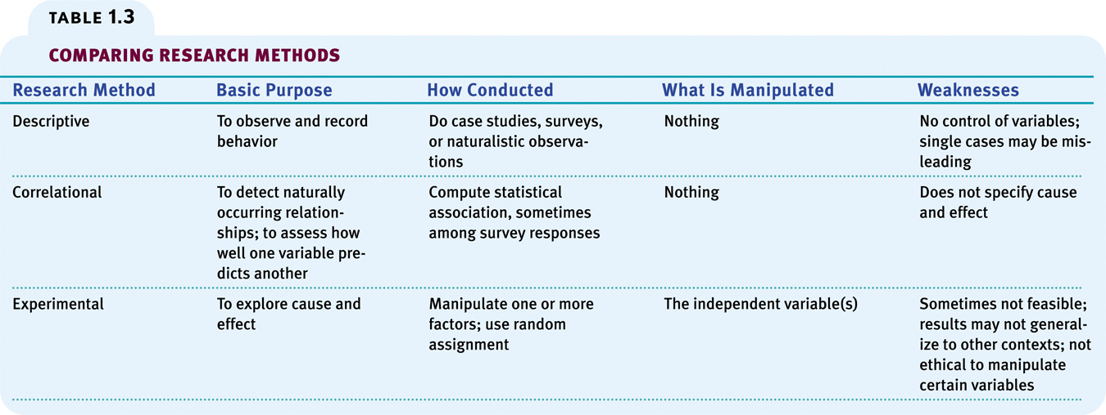

Slide 39
Research Question Options (pick one)
Do we learn while we sleep?
Does stress affect performance? (You can design an experiment based on either animals or humans) Do our emotions affect how easily different types of memories (e.g. happy or sad memories) are retrieved?
Does stress increase the likelihood of illness?
Basic emotions, such as anger, happiness, and sadness, are expressed and perceived in the same way across all cultures. The smell of fresh cookies makes people more willing to buy a house. Time goes by more slowly when we are bored.
Brain training games (e.g. Luminosity) increases users’ intelligence.
Consider:
What is your independent variable (i.e., what are you manipulating), and what is your dependent variable (i.e., what are you measuring)
Operationalization of the variables
Controlling for extraneous variables
Participant criteria/selection
Materials you will need
Procedure that participants will go through
What is the predicted result, and why (or for bonus points: If you can make multiple different predictions, state why each of the different outcomes may arise and what each would mean)?
What would be your conclusion, if the predicted result(s) were true

